Slide 1
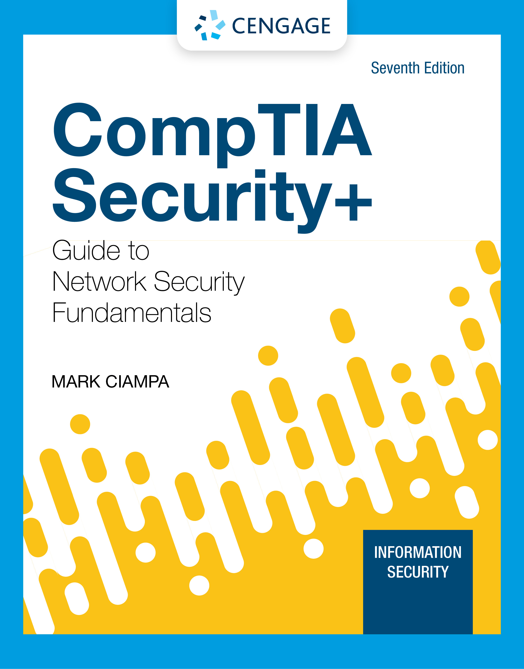
Module 3: Threats and Attacks on Endpoints
CompTIA Security+ Guide
to Network Security Fundamentals, 7th Edition

Slide 2
Module Objectives
By the end of this module, you should be able to:
1. Identify the different types of attacks using malware
2. Define application attacks
3. Explain how threat actors use application attacks
4. Define adversarial artificial intelligence attacks

Slide 3
Attacks Using Malware
Malware is software that enters a computer system without the user’s knowledge or consent and then performs an unwanted and harmful action
Malware is most often used as the general term that refers to a wide variety of damaging software programs
Malware is continually evolving to avoid detection by improved security measures
One attempt at classifying the diverse types of malware can be to examine the primary action that the malware performs:
Imprison
Launch
Snoop
Deceive
Evade

Slide 4
Imprison (1 of 4)
Some types of malware attempt to take away the freedom of the user to do what they want
Types of malware that imprisons are ransomware and cryptomalware
Ransomware
Ransomware prevents a user’s endpoint device from properly and fully functioning until a fee is paid
Some ransomware pretends to come from a law enforcement agency while others pretend to come from a software vendor and displays a fictitious warning that a license has expired

Slide 5
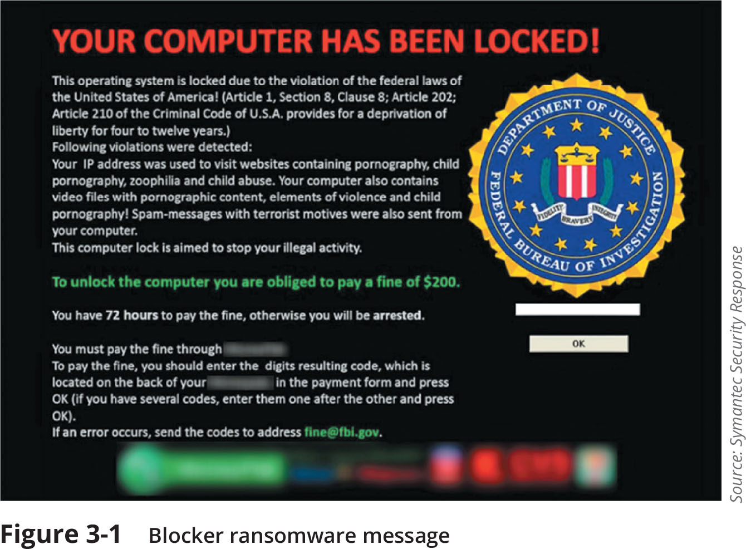
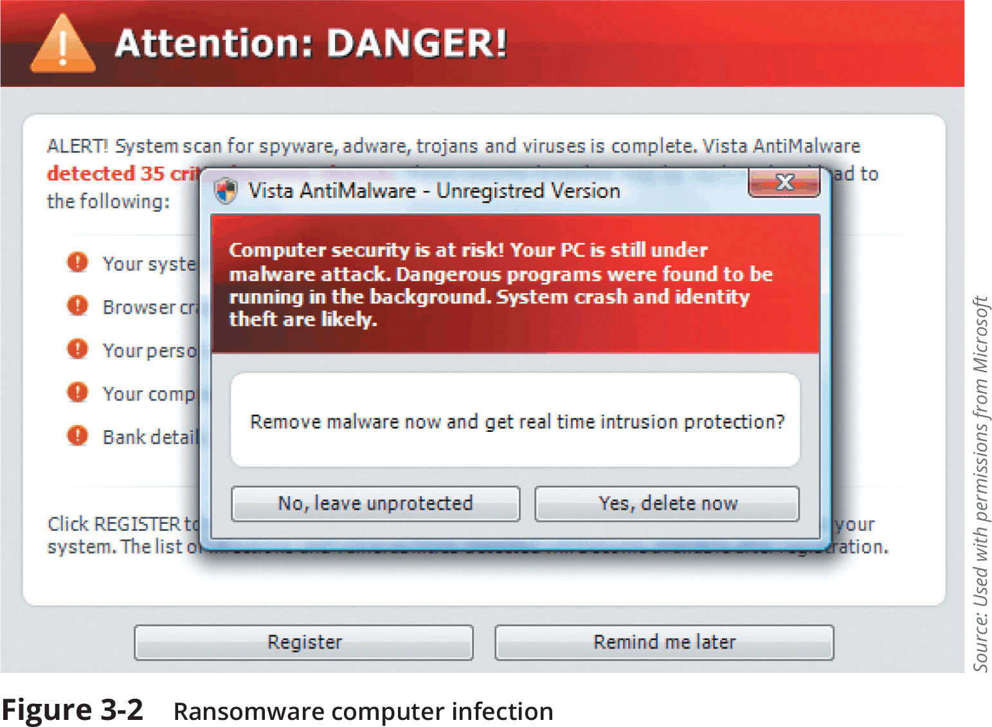
Imprison (2 of 4)

Slide 6
Imprison (3 of 4)
Cryptomalware
Cryptomalware is a type of malware that imprisons users and encrypts all files on the device so that none of them can be opened
The cost for the key to unlock the cryptomalware increases every few hours or days
New variants of cryptomalware encrypt all files on any network or attached device connected to that computer

Slide 7
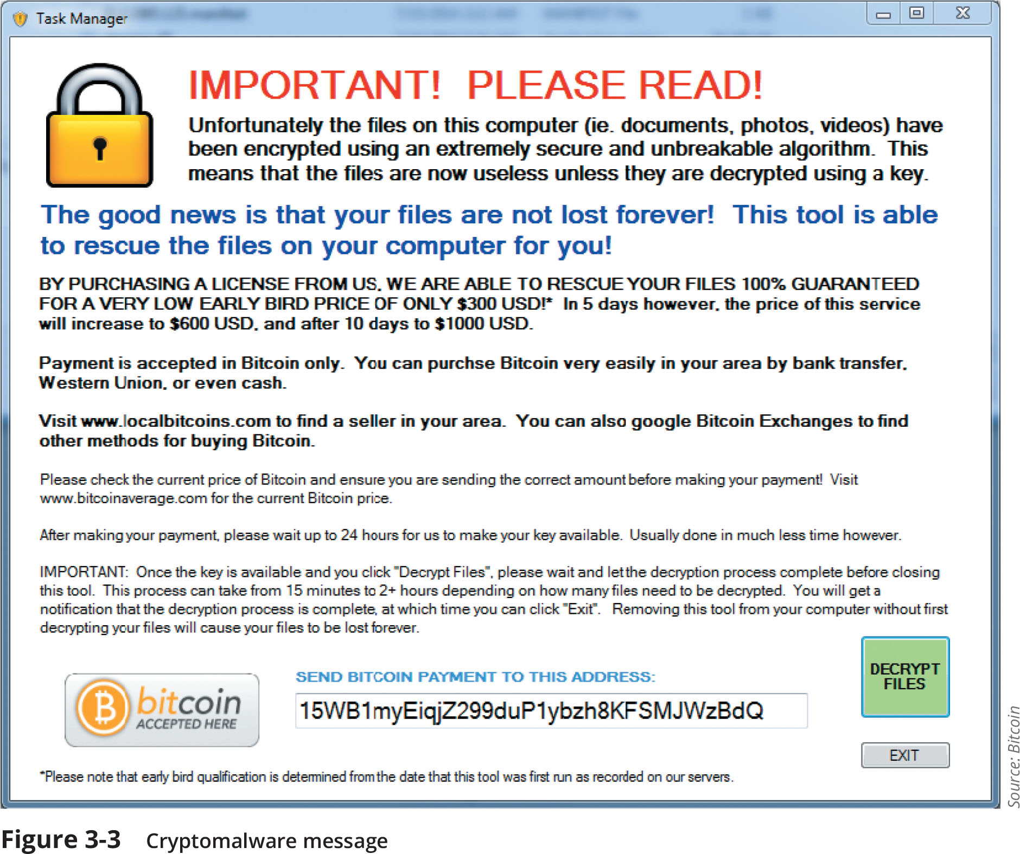
Imprison (4 of 4)
Figure 3-3 Cryptomalware message

Slide 8
Launch (1 of 5)
Malware that infects a computer to launch attacks on other computers includes a virus, worm, and bot
Virus
There are two types of viruses: a file-based virus and a fileless virus
A file-based virus is malicious code that is attached to a file that reproduces itself on the same computer without any human intervention
An armored file-based virus goes to great lengths to avoid detection
Techniques include split infection and mutation
The virus first unloads a payload to perform a malicious action, then the virus replicates itself by inserting its code into another file (on the same computer)

Slide 9
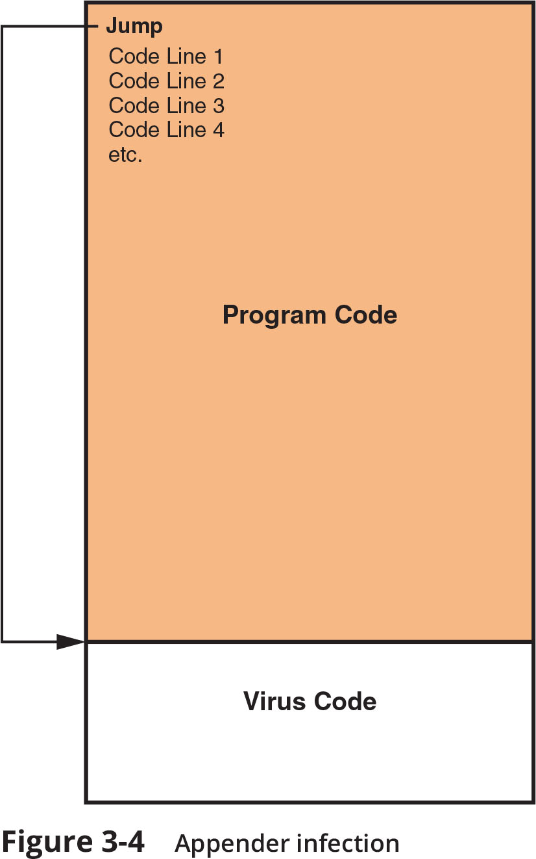
Launch (2 of 5)
Figure 3-4 Appender infection

Slide 10
Launch (3 of 5)
A fileless virus does not attach itself to a file but instead takes advantage of native services and processes that are part of the OS to avoid detection and carry out its attacks
It does not infect a file, instead the code is loaded directly in the computer’s random access memory (RAM)
Advantages of a fileless virus over a file-based virus:
Easy to infect
Extensive control
Persistent
Difficult to detect
Difficult to defend against

Slide 11
Launch (4 of 5)
Worm
A worm is a malicious program that uses a computer network to replicate (sometimes called a network virus)
Designed to enter a computer through the network and then take advantage of a vulnerability in an application or an OS on the host computer
Today’s worms can leave behind a payload on the systems they infect and cause harm, much like a virus
Actions that worms have performed include deleting files on the computer or allowing the computer to be remotely controlled by an attacker

Slide 12
Launch (5 of 5)
Bot
Another type of malware allows the infected computer to be placed under the remote control of an attacker for the purpose of launching attacks
The infected robot computer is known as a bot or zombie
When hundreds, thousands, or even millions of bot computers are gathered into a logical computer network, they create a botnet under the control of a bot herder
Infected bot computers receive instructions through a command and control (C&C) structure from the bot herders

Slide 13
Snoop (1 of 2)
Two common types of snooping malware are spyware and keyloggers
Spyware
Spyware is tracking software that is deployed without the consent or control of the user
Keylogger
A keylogger silently captures and stores each keystroke that a user types on the computer’s keyboard
The threat actor can then search the captured text for any useful information such as passwords, credit card numbers, or personal information
A keylogger can be a software program or a small hardware device

Slide 14
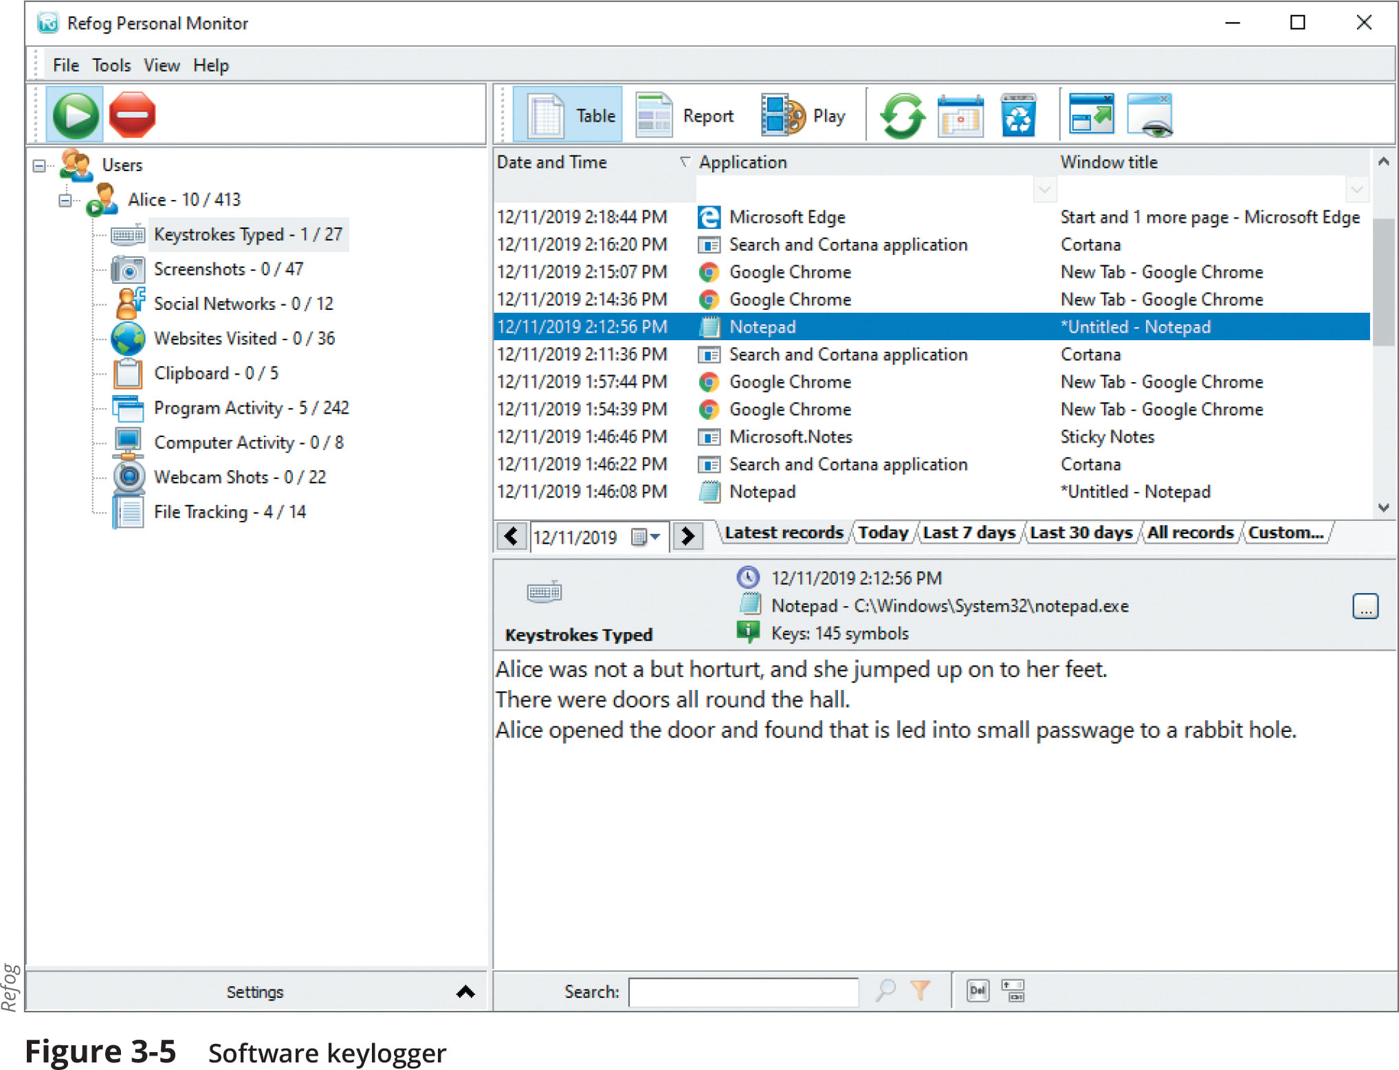
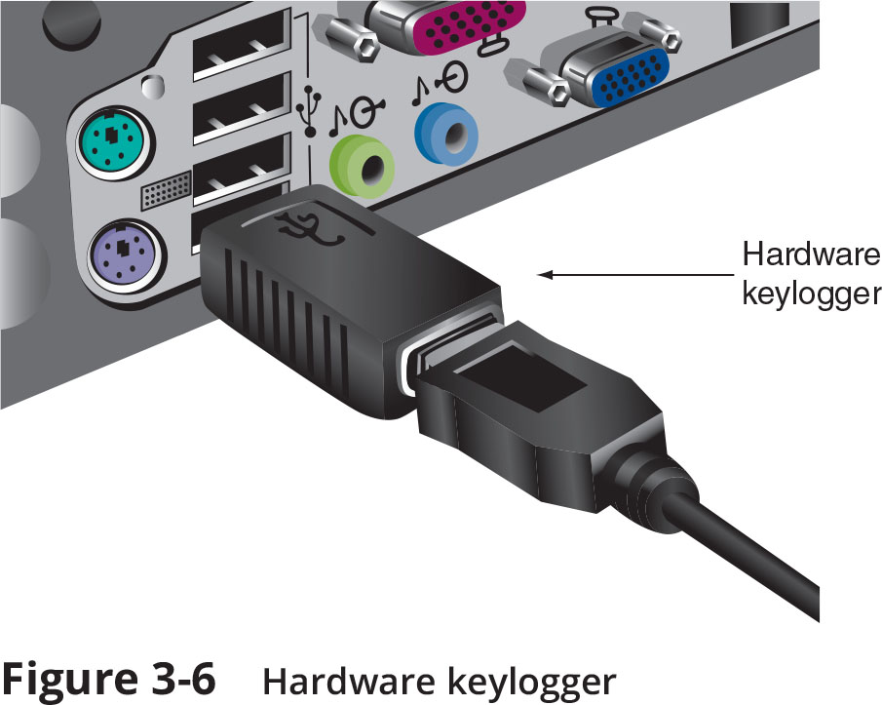
Snoop (2 of 2)

Slide 15
Deceive (1 of 2)
Some malware attempts to deceive the user and hide its true intentions
Examples include potentially unwanted programs (PUPs), Trojans, and remote access Trojans (RATs)
Potentially Unwanted Program (PUP)
A PUP is software that the user does not want on their computer
Examples of PUPs:
Advertising that obstructs content or interferes with web browsing, pop-up windows, pop-under windows, search engine hijacking, home page hijacking, etc

Slide 16
Deceive (2 of 2)
Trojan
A computer Trojan is an executable program that masquerades as performing a benign activity but also does something malicious
Remote Access Trojan (RAT)
A RAT has the basic functionality of a Trojan but also gives the threat agent unauthorized remote access to the victim’s computer by using specially configured communication protocols
This creates an opening to the victim’s computer allowing the threat agent unrestricted access

Slide 17
Evade
This category of malware attempts to help malware or attacks evade detection
Includes backdoor, logic bomb, and rootkit
Backdoor
A backdoor gives access to a computer, program, or service that circumvents any normal security protections
Logic bomb
A logic bomb is computer code that is typically added to a legitimate program but lies dormant and evades detection until a specific logical event triggers it
Rootkits
A rootkit is malware that can hide its presence and the presence of other malware on the computer
It does this by accessing “lower layers” of the OS to make alterations

Slide 18
Knowledge Check Activity 1
What is the primary action that cryptomalware performs?
a. Imprison
b. Launch
c. Snoop
d. Deceive

Slide 19
Knowledge Check Activity 1: Answer
What is the primary action that cryptomalware performs?
Answer: a. Imprison
This type of malware imprisons users and encrypts all files on the device so that none of them can be opened without a key for which the victim must pay the attacker.

Slide 20
Application Attacks
Another category of attacks look for vulnerabilities in applications or manipulate applications in order to compromise them
Common targets of attackers using application attacks are Internet web server
A web server provides services that are implemented as “web applications” through software applications running on the server

Slide 21
Scripting
In a cross-site scripting (XSS) attack, a website that accepts user input without validating it and uses that input in a response can be exploited
An attacker can take advantage in an XSS attack by tricking a valid website into feeding a malicious script to another user’s web browser

Slide 22
Injection
Attacks called injections introduce new input to exploit a vulnerability
One of the most common injection attacks (SQL injection) inserts statements to manipulate a database server
SQL stands for Structured Query Language
SQL injection targets SQL servers by introducing malicious commands into them
By entering crafted SQL statements as user input, information from the database can be extracted or the existing can be manipulated

Slide 23
Request Forgery (1 of 4)
Request forgery is a request that has been fabricated
There are two types of request forgeries:
Cross-site request forgery (CSFR) and a server-site request forgery (SSRF)
Cross-Site Request Forgery (CSRF)
CSRF takes advantage of an authentication “token” that a website sends to a user’s web browser
If a user is currently authenticated on a website and is then tricked into loading another webpage, the new page inherits the identity and privileges of the victim, who may the perform an undesired function on the attacker’s behalf

Slide 24
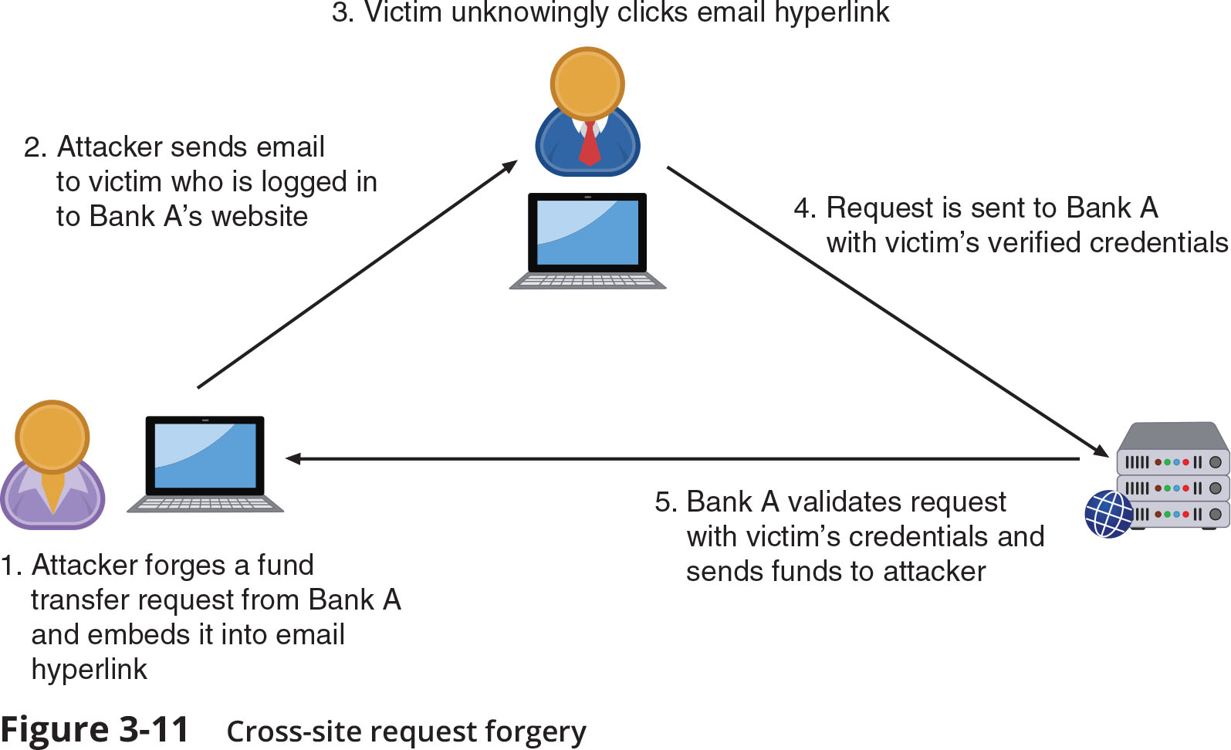
Request Forgery (2 of 4)
Figure 3-11 Cross-site request forgery

Slide 25
Request Forgery (3 of 4)
Server-Site Request Forgery (SSRF)
An SSRF takes advantage of a trusting relationship between web servers
SSRF attacks exploit how a web server processes external information received from another server
Some web applications are designed to read information from or write information to a specific URL
If an attacker can modify that target URL, they can potentially extract sensitive information from the application or inject untrusted input into it

Slide 26
Request Forgery (4 of 4)
Attack Name | Attack Target | Purpose of Attack
CSRF | User | Force target to take action for attacker while pretending to be authorized user
SSRF | Web server | Gain access to sensitive data or inject harmful data

Slide 27
Replay
Replay attacks are commonly used against digital identities
After intercepting and copying data, the threat actor retransmits selected and edited portions of the copied communications later to impersonate the legitimate user
Many digital identity replay attacks are between a user and an authentication server

Slide 28
Attacks on Software (1 of 3)
Other attacks are directly focused on vulnerabilities in the software applications
These include:
Exploiting memory vulnerabilities
Improper exception and error handling
External software components
Memory Vulnerabilities
Some memory-related attacks are called resource exhaustion attacks because they “deplete” parts of memory and thus interfere with the normal operation of the program in RAM
Other memory-related attacks attempt to manipulate memory contents such as buffer overflow attacks and integer overflow attacks

Slide 29
Attacks on Software (2 of 3)
Memory Vulnerabilities (continued)
A buffer overflow attack occurs when a process attempts to store data in RAM beyond the boundaries of a fixed-length storage buffer
This extra data overflows into the adjacent memory locations
In an integer overflow attack, an attacker changes the value of a variable to something outside the range that the programmer had intended by using an integer overflow
Improper Exception Handling
Some attacks are the result of poor coding on the part of software developers
Software that allows the user to enter data but has improper input handling features does not filter or validate user input to prevent a malicious action
Another improper exception handling situation is a NULL pointer/object dereference
When an application dereferences a pointer that has a value of NULL, it typically will cause a program to crash or exit

Slide 30
Attacks on Software (3 of 3)
Attacks on External Software Components
In addition to attacking the software directly, threat actors also target external software components
These include the following:
Application program interface (API)
Device driver
Dynamic-link library (DLL)

Slide 31
Knowledge Check Activity 2
Which type of application attack might use the following syntax?
‘whatever’ AND email IS NULL;
a. Cross-site scripting
b. Client-side request forgery
c. SQL injection
d. Buffer overflow

Slide 32
Knowledge Check Activity 2: Answer
Which type of application attack might use the following syntax?
‘whatever’ AND email IS NULL;
Answer: c. SQL injection
An SQL injection attack inserts statements to manipulate a database server. The statement in the question can determine the names of different fields in the database.

Slide 33
Adversarial Artificial Intelligence Attacks
Cybersecurity is using artificial intelligence to enhance the detection of malicious behavior and advanced threats
However, there are significant vulnerabilities and risks with using these new tools
Understanding them includes:
Knowing what the tools are and what they can do
How these tools are used in cybersecurity
Knowing their potential risks

Slide 34
What Are Artificial Intelligence (AI) and Machine Learning (ML)?
The definitions of AI vary, but AI may be defined as technology that imitates human abilities
A recognized subset of AI is machine learning (ML)
ML is defined as “teaching” a technology device to “learn” by itself without the continual instructions of a computer programmer
ML also involves learning through repeated experience
If something attempted does not work, then it determines how it could be changed to make it work

Slide 35
Uses in Cybersecurity (1 of 2)
Cybersecurity AI allows organizations to detect, predict, and respond to cyberthreats in real time using ML
Virtually all email systems use some type of AI to block phishing attacks
The prime advantages of using AI to combat threats are continual learning and greater speed in response
AI can predict and prevent future attacks
About one in five organizations used cybersecurity AI before 2019
Increasing to two out of three organizations planning to deploy it by the end of 2020

Slide 36
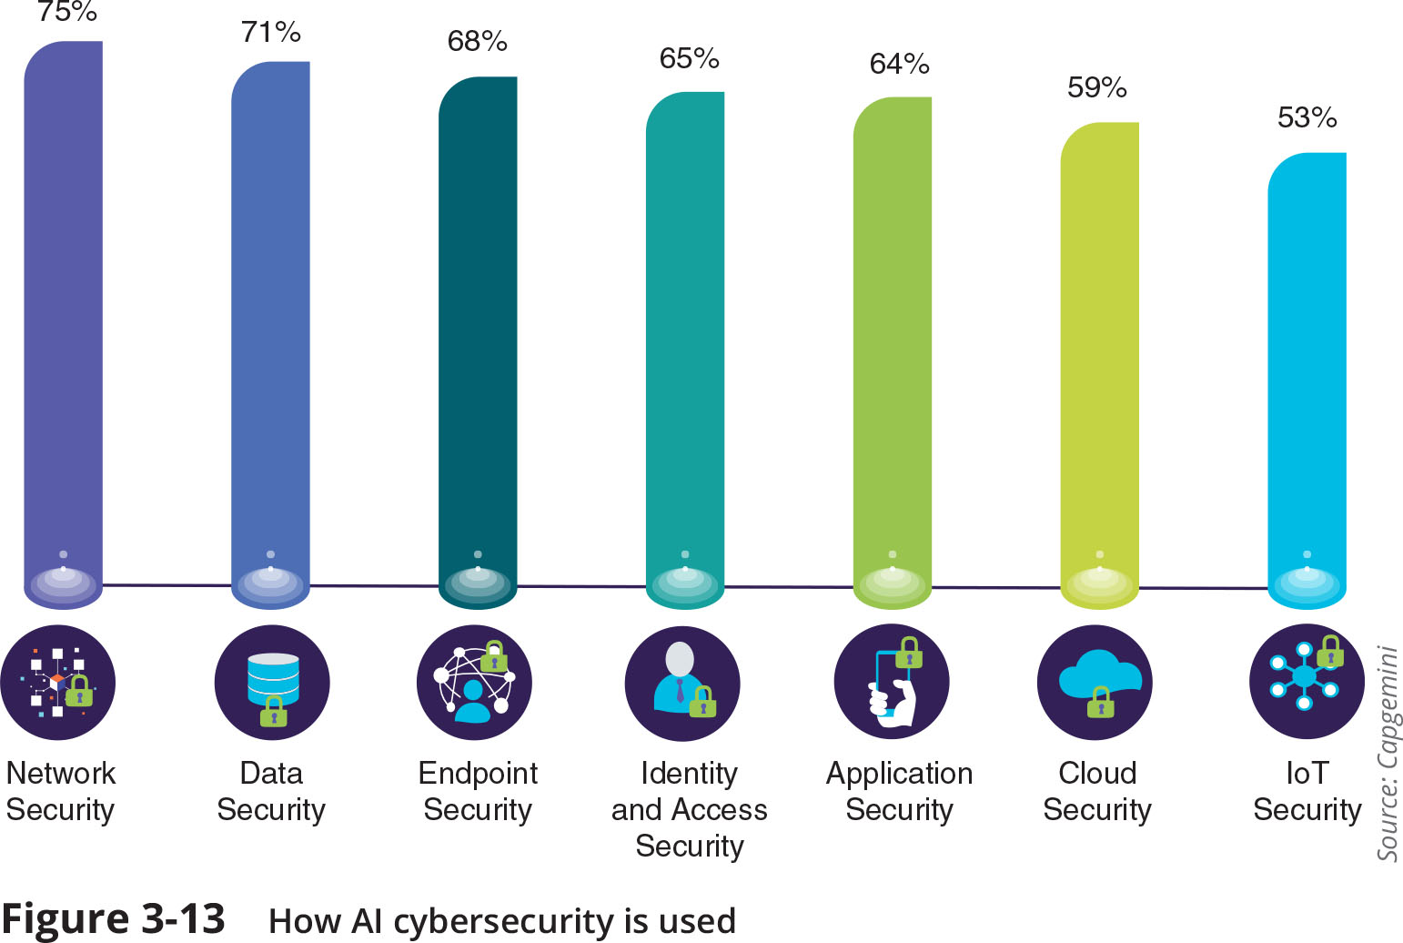
Uses in Cybersecurity (2 of 2)
Figure 3-13 How AI cybersecurity is used

Slide 37
Risks in Using AI and ML in Cybersecurity
Risks associated with using AI and ML are called adversarial artificial intelligence
The first risk is the security of ML algorithms
These could be attacked and compromised, allowing threat actors to alter algorithms to ignore attacks
Another risk is tainted training data for machine learning
Attackers can attempt to alter the training data that is used by ML in order to produce false negatives to cloak themselves

Slide 38
Knowledge Check Activity 3
Which of the following is a concern of using AI and ML in cybersecurity?
a. Buffer overflows
b. Improper input handling
c. Device driver manipulation
d. Tainted training data

Slide 39
Knowledge Check Activity 3: Answer
Which of the following is a concern of using AI and ML in cybersecurity?
Answer: d. Tainted training data
Attackers can attempt to alter training data that is used by machine learning in order to produce false negatives and cloak themselves.

Slide 40
Self-Assessment
Use the knowledge about malware you gained from this module to answer the following question: With the trend towards employees working from home, which type of malware do you think presents the most risk for organizations and their employees? Why? What are some things that can be done to mitigate the risks?

Slide 41
Summary (1 of 2)
The word “endpoint” is commonly used when referring to network-connected hardware devices
Malware is software that enters a computer system without the user’s knowledge or consent and then performs an unwanted and harmful action
Some types of malware attempt to take away the freedom of users
Another category of malware infects a computer to then launch attacks on other computers
Another category of malware “snoops” or spies on its victims
Some malware attempts to deceive the user and hide its true intentions
Some malware attempts to evade detection
Another category of attacks specifically targets software applications that are already installed and running on the device

Slide 42
Summary (2 of 2)
A cross-site request forgery (CSRF) takes advantage of an authentication “token” that a website sends to a user’s web browser
Several attacks are directed at vulnerabilities associated with how a program uses RAM
Software that allows the user to enter data but has improper input handling features does not filter or validate user input to prevent a malicious action
In an application program interface (API) attack, a threat actor looks for vulnerabilities in the API, a link provided by an OS, web browser, or other platform that allows a developer access to resources at a high level
Artificial intelligence (AI) is technology that imitates human abilities

